Slide 1
‘Teen pregnancy’ to
‘young motherhood’: considering the impact on women’s pregnancy decisions.
Dr Sarah Bekaert, Oxford Brookes University
Generations, Socialisation and Adult Identity
Canterbury Christ Church University, 13th September 2018

Slide 2
summary
Background to question; brief overview of the research study
Movement from teen to ’elastic’ term young mother
The view from ‘young motherhood’
Implications for women’s family planning

Slide 3
How this all started…
Teen health service, Teenage Pregnancy Strategy, Assertive Outreach
Abortion then motherhood - failure?
Explore the relational and socio-political context of the teenage women’s pregnancy decisions evident in their narratives
Theorise and contribute to an apparent gap in professional’s knowledge regarding reproductive decisions in some teenaged women’s lives
inform practice, and specifically the Assertive Outreach approach in the host service

Slide 4
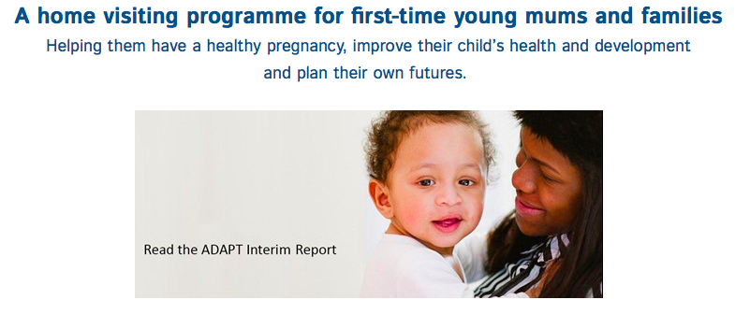

Socio-political Background
Public scrutiny/critical point -Teenage Pregnancy Strategy (SEU 1999)
‘Success’ yet increased stigma (Fearley 2018)
Current socio-political expectations in the UK for the teenage years: commitment to education as a route to social mobility, avoidance of pregnancy and parenthood – or face ‘social exclusion’
Teenaged women who become pregnant, regardless of outcome, are expected to return to education and are subject to targeted intervention to avoid repeat pregnancy

Slide 5
Literature overview
Repeat pregnancy, company for siblings, finish family (Herrman 2006, 2007)
Metasynthesis/historical: ‘waves’ of evidence: alarmist paradigm, control for other influences TP cofactor not cause, positive aspects (SmithBattle 2018)
Historical: moral/developmental/‘economic science’ teenage parenthood (Goncalves et al 2011)/‘deviant to dependant’ (Arai 2009)
Notes:
Pam Aldred’s (1999) exploration of ‘fitness to parent’
Berry Mayall’s (1998, p270) discussion of how children are increasingly viewed as ‘socialisation projects’.
alarmist paradigm - statisitcal Guttmacher Institute/Teenage Pregnancy Unit (early 1990s); control for other influences TP cofactor not cause (Geronimus, Burton, Phoenix 1990s)positive dimensions (SmithBattle, Herrman, Arai, Ellis-Sloan late 1990s onwards…)

Slide 6
Methodological considerations
Feminist reflexive approach
    to carry out research for, and not on, women
    illuminating women’s social conditions and experience
    to advocate for social change on behalf of women
    exposing and challenging the operation of male power
    mindful of the power inherent in the researcher’s role within the research relationship (Wilkinson, 1988, 1996)
Concepts of governmentality to attend to ways in which women’s sexuality is regulated through policy, clinical, and research practice (Foucault 1980, Rose 1990)
8 teenage women
Data analysis: Listening Guide (Taylor et al 1996, Mauthner and Doucet 1998)
Notes:
such interpersonal, and possibly, regulatory frameworks within which the young women were making and narrating their pregnancy decisions I drew on Foucault’s conceptual work which explored how the ‘state’ exerts its power on its ‘citizens’, and which located the citizen in opposition to the state (1976, p85).
polymorphous techniques of power’ that have ‘exploded’ in the attempt to control sexuality across the centuries (Foucault 1976, p11). Foucault’s concept of resistance (Foucault 1976) was also important in considering whether, and how, the young women ‘resisted’ the dominant discourse of ‘non-reproduction’ (Smith 2014) in the teenage years
technologies of self (Foucault 1976, p90). For example, the above regulatory activity leads to the expectation that teenagers maintain a non-reproductive body (Smith 2014).
Rose explored how citizens of a liberal democracy are expected to regulate themselves; and government mechanisms construe them as active participants in their lives. Citizens are no longer dominated, but educated into ‘an alliance between personal objectives and ambitions and institutionally or socially prized goals’ (Rose 1990, p10).
Phoenix noted that the important element to draw out in relation to the co-constructed interview is how local contexts, the immediate context in which the interview takes place or in other words the participant-researcher relationship, and wider social contexts are inextricably linked (Phoenix 2008, p66).

Slide 7
Findings/analysis
main ‘story’ of how the young women foregrounded identities of self as ‘good citizens’/responsibilisation narratives:
    Importance of finishing/returning to education
    Failed contraception, infertility, fate, beyond legal time for abortion
    Moving towards marriage and nuclear family living
Muted desire for pregnancy and parenthood

Slide 8
Commitment to education
'I wanted to get my education straight’ (Ally)
'At that point there I had a termination. But this was before I had to do my GCSEs...The reason being was because I knew full well that I needed these qualifications…to move on in life.’ (Sandra)
Different from Tabberer et al’s (1999) study younger carry on, older terminate
scholarisation of the child (Qvortrup 2005)

Slide 9
upward mobility or rite of passage?
‘I came off it
I didn’t want to do it no more
I came off it
I didn’t go back
I thought what’s the point
I’ve done my GCSEs
I’m a big girl now'.
(Sandra, 17)

Slide 10
Return to Education
I will go back to school…I know where I want to be in life. So if it means I have to go back and do another 3 years I’ll go back and do another 3 years and no problem… I’ve got high expectations that I need to meet and I will meet cos if I don’t meet them I’ll feel like a failure and I don’t want to be feeling like that. (Sandra)
By September I need to be in college, I need to be in college for…more than 3 years, I want to be in uni and that’s it…For (daughter) I don’t want her to be like oh my mum she doesn’t do anything with her life.’ (Danielle)
Once a parent aim to return to education and work (Benson 2017, SmithBattle 1996)
Full time motherhood = failure? Not doing anything with life?

Slide 11

education
The internalised desire to complete/return education reflected Rose’s (1990) concept of governmentality: personal desires have come to reflect state desires
Extension of school leaving age to 18 50% of young people to attend university – how might this affect young women’s pregnancy and mothering decisions?

Slide 12
From teen to the ‘elastic’ term young motherhood
Focus on under 16’s unplanned pregnancy in the Health of the Nation document (DH 1992)
to under 18s in the Teenage Pregnancy Strategy (SEU 1999)
to the current Framework for Supporting Teenage Mothers and Young Fathers (PHE 2016) where the focus age range had shifted further to 20.
Policy, guidance and media take this into 20s and sometimes beyond…

Slide 13
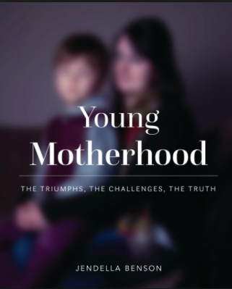
Young motherhood – Jendella Benson
24 women aged 15-22, only 6 were under 18 and 5 were 20 years or older
Angella (20)–….stopped on the street, you’re a baby with three children where’s the dad!!!,
Demelza (19)- people really don’t like young parents for a lot of reasons but mostly economic… ‘acceptable discrimination’…
Tanya (18) – I can see how having a child young can disdvantage you….

Slide 14
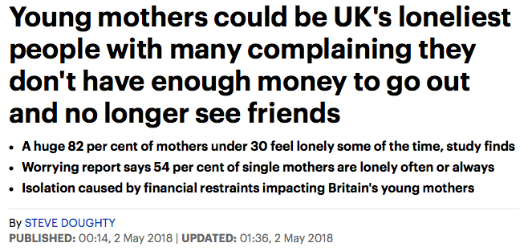
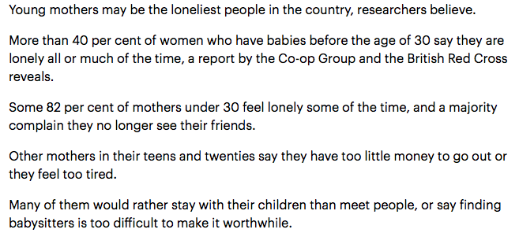


Slide 15

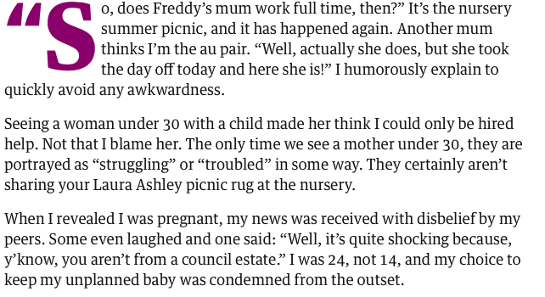


Slide 16

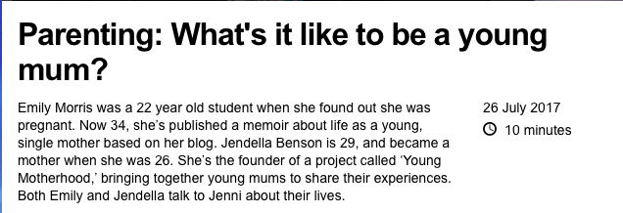

Slide 17
Research
Ellis-Sloan (2013) Teenage pregnancy associated with negative stereotypes, linked to welfare dependency, promiscuity and irresponsibility; architects of own fate and undeserving of support
Whitley and Kirmayer (2008) ‘Anglophone Euro-Canadian participants in their early 20s felt strongly stigmatised as mothers…may now be experiencing aspects of social exclsuion traditionally associated with ‘teenage mothers’
Valorisation of career and educational achievement as markers of ‘success’ (Whitley and Kirmayer 2008)
This may have a deleterous effect on health – lack of self esteem and post natal depression... (Whitley and Kirmayer 2008)

Slide 18
legislation
Legislation fuelling and compounding popular perceptions
Extension school leaving age 18
Benefits – change in living wage, universal credit at 25, discriminates against younger people and mothers under 25
Others?
‘Unsettling legislative shift that disadvantages those who mother earlier than the norm. The1970 birth cohort study showed that teenaged mothers did catch up by age 30 - would this still be true?’ (Bradley 2017)

Slide 19
summary
Legislative activity extending education etc extends control of women’s fertility
Devaluing of motherhood (only valued in very narrow parameters – white/middle class/middle aged)
The window of ‘opportunity’ for it to be socially acceptable for women to have children is narrowing… biological and socio-cultural clock....(Loyal 2018)

Slide 20
Semantic tension!
‘There is stigma attached to ‘teenage’ mothers so most teen-age mothers prefer to identify as young mothers’ (Bradley 2017)
Teenaged mothers who have since passed their 20th birthday may still feel or experience some of the stigma of being a teenage mother, e.g. I still may call myself a young mother as, at 38, I am younger that other parents of 21 year olds’ (Bradley 2017)
YET popular use extends stigma in use of ‘young’ which can be used ‘elastically’; negative self esteem and health consequences, wider issues relating to the control of women’s fertility…

Slide 21
Conclusion?
    How to advocate for social change on behalf of women?
Discuss!!
Thank you

Slide 22
references
Arai, L. 2009. Teenage pregnancy: The making and unmaking of a problem. Policy Press. London.
Benson, J. 2017. Young Motherhood. The Triumphs, the Challenges, the Truth. Word is Bond Publishing. UK.
Bradley, J. 2017. Private correspondance. @prymface
DH. 1992. Health of the Nation. HMSO. London.
Ellis-Sloan, K., 2014. Teenage mothers, stigma and their ‘presentations of self’. Sociological Research Online, 19(1), pp.1-13.
Fearley, B. 2018. An investigation into the lived experiences of young women who are also mothers. Critical Public Health. 17(4), pp311-316.
Foucault, M., 1980. Power/knowledge: Selected interviews and other writings, 1972-1977. Pantheon. UK.
Goncalves, H., Souza, AD., Tavares, PA., Cruz, SH. and Behague, DP. 2011. Contraceptive medicalisation, fear of infertility and teenage pregnancy in Brazil. Culture, health & sexuality, 13(2), pp. 201-215.
Herrman, JW. 2007. Repeat pregnancy in adolescence: intentions and decision making. MCN. The American journal of maternal child nursing, 32(2), pp. 89-94.
Herrman, JW. 2006. The voices of teen mothers: The experience of repeat pregnancy. MCN: The American Journal of Maternal/Child Nursing, 31(4), pp. 243-249.

Slide 23
references
Loyal, S. 2018. Exploring women's perceptions of reproductive timing within British South Asian communities: A qualitative study. Presentation at POWES conference 2018.
Mauthner, N. and Doucet, A. 1998. Reflections on a Voice- Centred Relational Method of Data Analysis: Analysing Maternal and Domestic Voices, pp. 119-144. In Feminist Dilemmas in Qualitative Research: Private Lives and Public Texts. Eds: Ribbens, J. and Rosalind Edwards, R. Sage, London.
Public Health England. 2016. A framework for supporting teenage mothers and young fathers. https://www.gov.uk/government/uploads/system/uploads/attachment_data/file/524506/PHE_LGA_Framework_for_supporting_teenage_mothers_and_young_fathers.pdf (accessed October 2016).
Qvortrup, J. 2005. Varieties of childhood. In Studies in modern childhood, pp. 1-20. Palgrave Macmillan UK.
Rose, N. 1990. Governing the soul: the shaping of the private self. Taylor and Frances/Routeledge, UK.
Social Exclusion Unit. 1999. Teenage Pregnancy Strategy. HMSO, London.

Slide 24
references
SmithBattle, L. 2018. Teen Mothering in the United States: Fertile Ground for Shifting the Paradigm. Pp75-104 in Re/Assembling the Pregnant and Parenting Teenager: Narratives from the field(s). Eds Kamp, A and McSharry, M. Oxford. Peter Lang.
SmithBattle, L. 1996. Intergenerational ethics of caring for adolescent mothers and their children. Family Relations, 45, pp. 56-64.
Tabberer, S., Hall, C., Prendergast, S. and Webster, A. 2000. Teenage pregnancy and choice. Joseph Rowntree Foundation, York.
Taylor, JM. Gilligan, C. and Sullivan, AM. 1996. Missing voices, changing meanings: Developing a voice-centred, relational method and creating an interpretive community. Feminist social psychologies: International perspectives, pp.233-257.
Whitley, R. and Kirmayer, L.J., 2008. Perceived stigmatisation of young mothers: An exploratory study of psychological and social experience. Social science & medicine, 66(2), pp.339-348.
Wilkinson, S. 1988. The role of reflexivity in feminist psychology. Women's Studies International Forum, 11(5), pp. 493-502.
Wilkinson, S. 1996. Feminist social psychologies: A decade of development, pp. 1-20. Feminist Social Psychologies. International Perspectives. Ed: Wilkinson, S. Open University Press. Buckingham, UK. Bristol, US.

