Slide 1
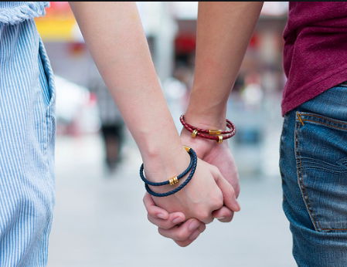
Intimate partner abuse in Teen Relationships
Dr Sarah Bekaert RN
Oxford Brookes University
Men and Families Conference, Toronto 2022

Slide 2

Introduction/background
Growing body of international evidence
Under-recognized
Negative health consequences
Poor school performance
Parallel and unique effects and outcomes of IPA for teenagers
(Ismail et al 2007, Kennedy et al 2010, Martsolf et al 2012, Chronister et al 2014, Hellevik 2019)

Slide 3
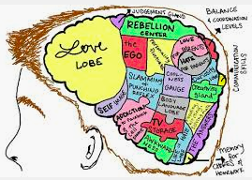
Adolescence
Neurological and socio-cultural aspects
Fragility and inexperience
DA - health risks and deleterious developmental outcomes, warrants specific focus
(Hanson and Holmes 2014, Gonzalez Guarda et al 2016)

Slide 4

Teenage pregnancy decision-making study
Violent contexts: relational, intergenerational, gendered, gang, drugs and alcohol
‘navigating risk in complex lives’
Parenthood – permission to withdraw, fresh start, ?unconditional love
Reciprocal violence
(Bekaert 2017, 2019, 2020, 2021a, 2021b, 2021c)
'So, them times I was pregnant and that’s the reason why I never went out, because to tell the truth if I weren’t pregnant I would’ve went out to see what he would do to me...'
(Angelique)

Slide 5
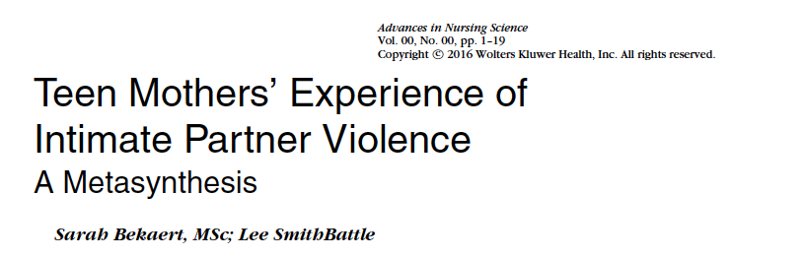
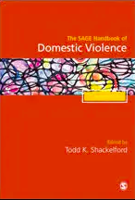
Metasyntheses
Two metasyntheses of literature:
- Teen mother’s experience of IPV (Bekaert and SmithBattle 2016)
- The experience of IPV in teenage relationships (Bekaert and Appleton 2021)

Slide 6
How teens describe the violence
Escalates over time
Purposeful and calculated/unreflective and spontaneous
An expression of deep feelings
Deserved
Acceptable in certain situations
Ensuring their partner stayed with them
‘You wanna hold them. Keep them away from people … but then you don’t want to hold them, because like it’s pretty much gonna end the relationship’.
(Baker and Carreño, 2016, p315).

Slide 7
Digital media
Catalyst for violence
Making negative comments about photos or posts
Being publicly insulting
Applying pressure to send intimate photos, redistributing intimate photos
Sending threatening messages
‘If you don’t return my phone calls, I will hunt you down. I will start at your house, and I will work my way from there’.
(Draucker and Martsolf 2010, p. 139).

Slide 8
Gendered aspects
‘Wow, you’re so psycho bitch. But it’s like – you made me like this’ .
(Baker et al 2015, p. 657)
Bidirectional, yet gendered
Young men - physical abuse, young women - psychological abuse
Self-defense and retaliation acceptable
Cheating permitted the use of violence

Slide 9
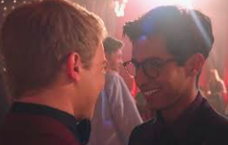
Same sex relationships – YMSM
Involved both partners
Threatening to ‘out’ the other
Internalized homophobia
Alcohol and drugs
Rarely challenged: violence between two men is more acceptable in society
Comparatively limited dating opportunities in early adolescence

Slide 10
Contextual considerations
‘Violence…it’s all around, you know? It’s just all around…like I’m walking down the street – this way the other day – and these guys ran up on me…and basically pulled a gun on me’ .
(Reed et al 2008, p. 266).
Learned behaviour
Part of general violence contexts
Male gang involvement/‘machismo’
A pregnancy can compound entrapment

Slide 11
Adolescent development as resource
Impulse control
Fear of social ostracism
Less experience - limits exit strategies
Desistance occurred through development
Pivotal moments for change
Difficulty in seeking help – lack of experience, desire for autonomy
‘It was just exciting to me at the time, but I grew out of it though’.
(Giordano et al 2015, p. 18).

Slide 12
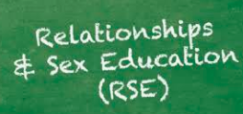


Recommendations
- Curriculum based relationship education
- Ask specifically about partner abuse
- Be ready for the ‘pivotal’ moments
- Recognise may take time to leave
- Trauma informed approach

Slide 13



Current research
Protecting children and young people vulnerable to harm and abuse:
Learning from School of Nursing practices and new ways of working in the Covid-19 pandemic.
A mixed methods study: SLR, survey, focus groups
‘But it's the ones that you pick up along the way you know, especially sexual health. We weren't able to kind of see young people to give them much (support)…and we know that pregnancies has gone up.’

Slide 14



Current research
When it happened I didn’t want to talk about it at all, because I didn’t feel comfortable talking about it… To be honest it has helped me quite a lot as it’s shown me that there’s so much more to life. Casey, 15
Evaluating the impact of a Navigator mentorship programme for young people attending the Emergency Department as a result of violence
Thames Valley Police Violence Reduction Unit/Home Office (gov)
5 acute trusts across the Thames Valley
Mixed methods: quantitative engagement data/experiential accounts

Slide 15

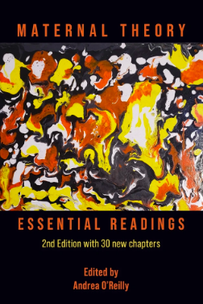
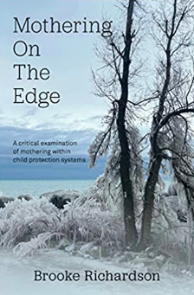
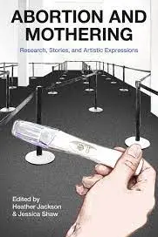
sbekaert@brookes.ac.uk
@sarahbekaert
https://drsarahbekaert.net/

Slide 16
references
Baker, C.K., Helm, S., Bifulco, K. and Chung-Do, J., 2015. The relationship between self-harm and teen dating violence among youth in Hawaii. Qualitative health research, 25(5), pp.652-667.
Bekaert, S. and SmithBattle, L., 2016. Teen Mothers' Experience of Intimate Partner Violence. Advances in Nursing Science, 39(3), pp.272-290.
Bekaert, S and Appleton, JV. 2020. Ch 60. Intimate Partner Violence in Teenage Relationships, pp. 1004-1020, in the Sage Handbook of Domestic Violence, Ed: TK Shackelford. Sage.
Bekaert, S., 2021a. Teenaged mother's narratives: methodological dilemmas in tracing an emergent, yet muted, desire for motherhood. Community, Work & Family, pp.1-14.
Bekaert, S. 2021b. ‘I Want to Get My Education Straight’: The Impact of Contemporary Cultural Expectations on Teenage Pregnancy Decision Making. pp. 145-163, in Abortion and Mothering, Eds: Heather Jackson and Jessica Shaw. Demeter Press.
Bekaert, S. 2021c. Reconceiving Young Motherhood. Chapter 42, pp. 663-673, in Maternal Theory: Essential Readings, 2nd Edition, Ed: Andrea O'Reilly. Demeter Press.
Bekaert, S. 2020. Exploring the influences on teenage pregnancy decision-making using the Listening Guide data analysis method. Sage Research Methods Cases. DOI: https://dx.doi.org/10.4135/9781529732726
Bekaert, S. 2019. Teenage Mothers in England; Resisting or Silenced by the Regulatory Framework? pp: 105-118, in Motherhood in Contemporary International Perspective: Continuity and Change, 1st Edition, Ed: Fabienne Portier Le-cocq. Routledge.
Bekaert, S. 2017. ‘Hopefully He Puts the Ring on it…’, Teenaged Mothers’ Voiced Desire for Marriage, pp. 146-167, In Troubling the Fantasy of the Happy Ever After, Ed: Linda Ennis. Demeter Press..
Chronister, K.M., Marsiglio, M.C., Linville, D. and Lantrip, K.R., 2014. The influence of dating violence on adolescent girls’ educational experiences. The Counseling Psychologist, 42(3), pp.374-405.

Slide 17
Draucker, C.B. and Martsolf, D.S., 2010. The role of electronic communication technology in adolescent dating violence. Journal of Child and Adolescent Psychiatric Nursing, 23(3), pp.133-142.
Giordano, P.C., Johnson, W.L., Manning, W.D., Longmore, M.A. and Minter, M.D., 2015. Intimate partner violence in young adulthood: Narratives of persistence and desistance. Criminology, 53(3), pp.330-365.
Gonzalez-Guarda, R.M., Ferranti, D., Halstead, V. and Ilias, V.M., 2016. Experiences with dating violence and help seeking among Hispanic females in their late adolescence. Issues in mental health nursing, 37(4), pp.229-238.
Hanson, E. and Holmes, D. 2014. That difficult age; developing a more effective response to risks in adolescence. Research in Practice/ADCS.
Hellevik, P.M. 2019. Teenagers' personal accounts of experiences with digital intimate partner violence and abuse. Computers in Human Behavior, 92, pp.178-187.
Ismail, F., Berman, H. and Ward-Griffin, C. 2007. Dating violence and the health of young women: A feminist narrative study. Health Care for Women International, 28(5), pp.453-477.
Kennedy, A.C. Agbényiga, DL.Kasiborski, N., et al. 2010. Risk chains over the life course among homeless urban adolescent mothers: altering their trajectories through formal support. Children and Youth Services Review, 32(12), pp.1740-1749.
Martin, C.E., Houston, A.M., Mmari, K.N. et al. 2012. Urban teens and young adults describe drama, disrespect, dating violence and help-seeking preferences. Maternal and child health journal, 16(5), pp.957-966.
Martsolf, D.S., Draucker, C.B., Stephenson, P.L., et al. 2012. Patterns of dating violence across adolescence. Qualitative Health Research, 22(9), pp.1271-1283.
Reed, E., Silverman, J.G., Raj, A., Rothman, E.F., Decker, M.R., Gottlieb, B.R., Molnar, B., and Miller, E. (2008) Social and environmental contexts of adolescent and young adult male perpetrators of intimate partner violence: A qualitative study. American Journal of Men's Health, 2(3): 260–71.

