Slide 1







School Nursing in the time of covid: a UK perspective
Dr Sarah Bekaert
Oxford Brookes University
NCNR 2023 Conference, Rekjavik, Iceland

Slide 2
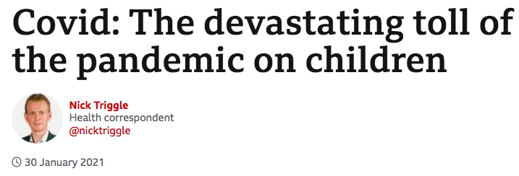
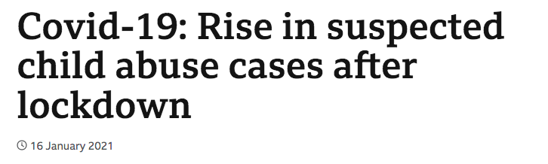
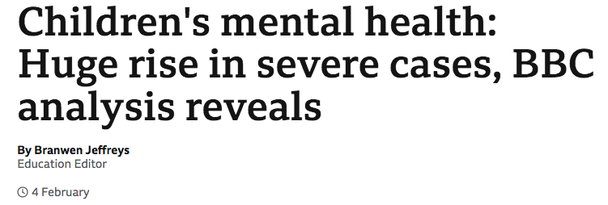
background
Social restrictions - Remote curriculum delivery
Universal and targeted support for children and young people usually delivered in schools
How SN supported and maintain ongoing contact with vulnerable children and young people?

Slide 3
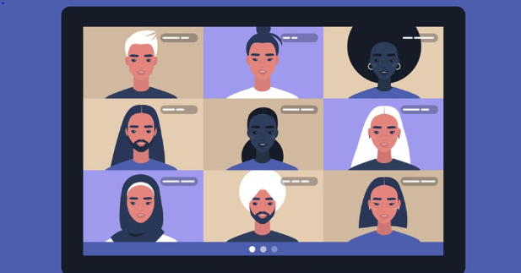
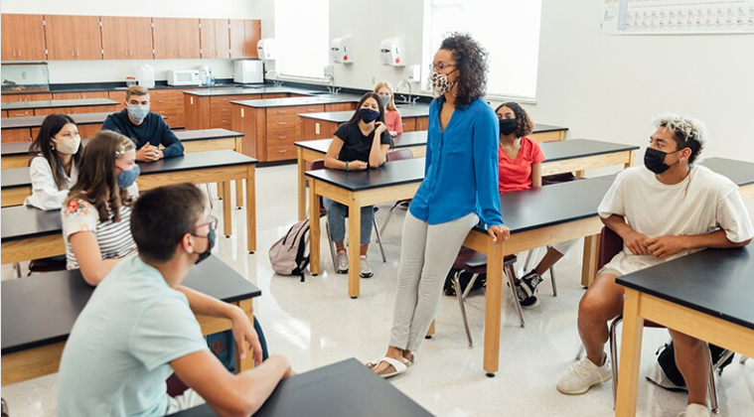

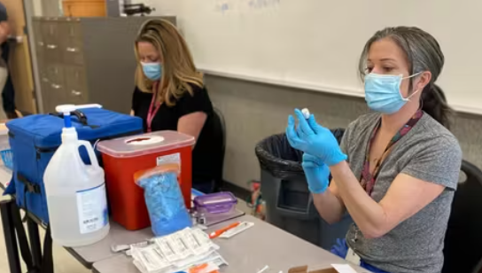
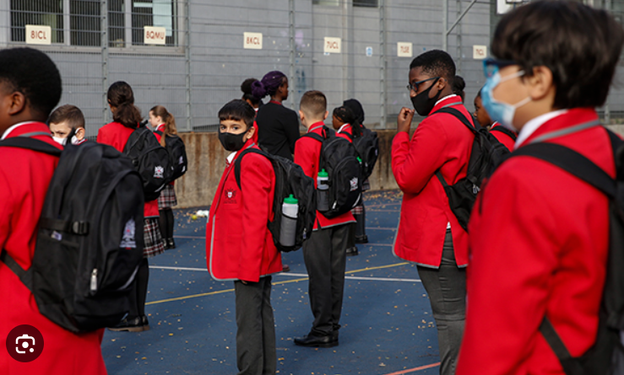
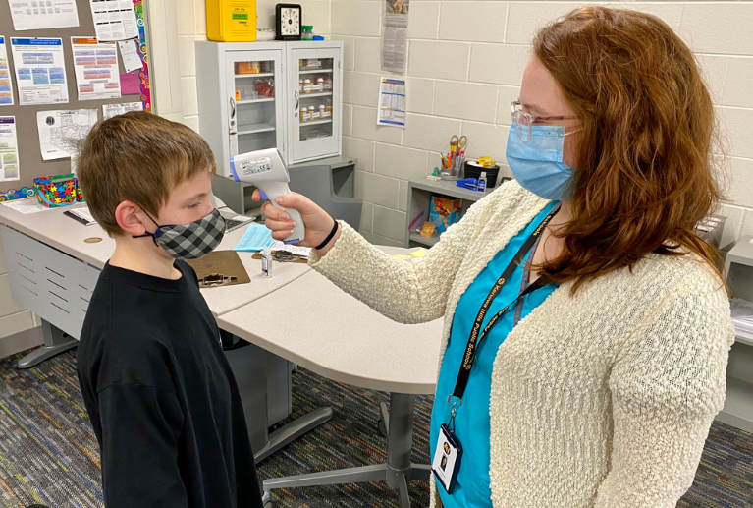
Stepping in…
Cook, G., Appleton, J.V., Bekaert, S., Harrold, T., Taylor, J. and Sammut, D., 2022. School nursing: New ways of working with children and young people during the Covid-19 pandemic: a scoping review.
Journal of Advanced Nursing. 79:471–501

Slide 4
Project aims
  Practical methods introduced, or accelerated, to aid school nursing practice (Internationally)
  Changes to interdisciplinary working (UK)
  New practices (if any) school nurses felt should endure post-pandemic (UK)
Phase 1
International literature review
Phase 2
UK wide survey
Phase 3
UK wide focus groups

Slide 5
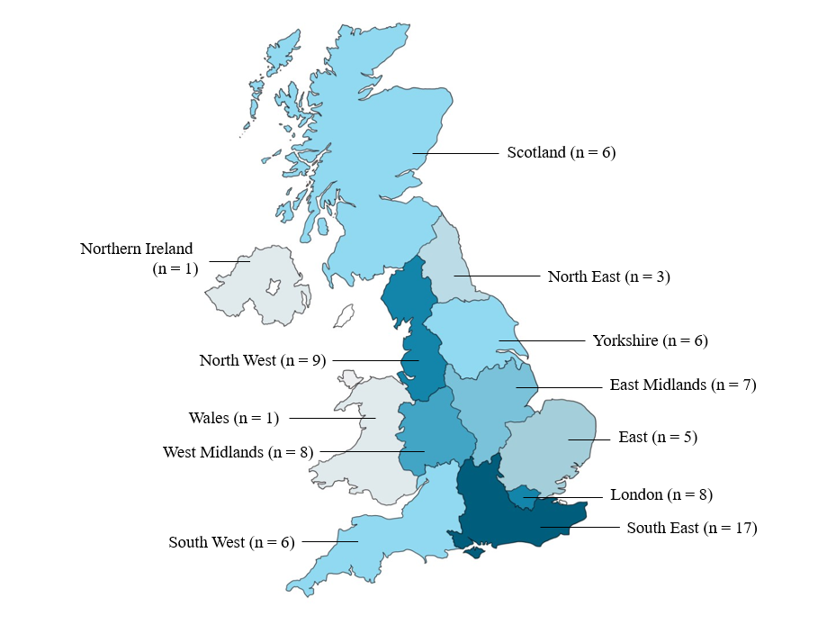
Phase 2 - Survey
78 fully completed responses
Data collected April – May 2022
Range of:
Experience
Locations
types of school
Part-time

Slide 6
Phase 2- survey: Qualitative findings
Safeguarding in the digital context:
“I don’t feel a phone/WhatsApp contact is as effective as face-to-face contact at home or school, [you are] unable to do home environment assessment, observe parent/child interactions, non-verbal communication etc.”
Preventive to reactive practice:
“School nursing was dominated by safeguarding work rather than our public health role”
Workforce:
“Staffing redeployment, staff exhaustion, remote working disrupting team working and morale”
Visibility:
“We were unable to gain the voice of the child as we lost the ability to meet with children and young people and build safe confidential relationships”
Interprofessional working:
“The respect of what we do and our safeguarding knowledge and experience was valued”
Sammut, D., Cook, G., Taylor, J., Harrold, T., Appleton, J. and Bekaert, S. 2022. School Nurse Perspectives of Working with Children and Young People in the United Kingdom during the COVID-19 Pandemic. An Online Survey Study International Journal of Environmental Research and Public Health, 20(1): 481.

Slide 7

Focus groups
20 participants
Focus groups / interviews
Conducted June – July 2022
Service delivery
The service users
The workforce
SN profile

Slide 8
Workforce
‘It was always very difficult to get police, always difficult to get education involved, and school nurses, all in one area, but actually, I think using the online facilities really, really helped. And that's something that I really want to continue with.’
Workforce
‘If you're on a strategy call – and you hear the most ghastly things – you put the call down, you've got no-one here to have ad hoc supervision with. What do you do? You go outside, you sit in your garden, and you cry. You know, what else can you do?’
School nursing profile
‘Often you would get social workers who have no idea about the type of job that we did, but as time went on, sometimes we’d be doing joint visits with them and things like that, and I think a lot of them really began to understand the value of the role of the school nurse.’
School nursing profile
‘We're on the map, it has put school nursing in [county] on the map, this Covid pandemic. Schools know who we are, because we've been contactable throughout the two years, and we have a lot more channels to be contactable now.’
Bekaert, S., Sammut, D., Appleton, J.V., Taylor, J., Harrold, T. and Cook, G. 2023. Learning from school nursing practices and new ways of working during the Covid-19 pandemic: a qualitative study. British Journal of Child Health, 4(2): 71-77.

Slide 9
feedback
Benefit from the shared learning this study offers
Format that is useful to school nurses
Next steps:
    Compendium of practice -‘tools’ introduced or accelerated during the pandemic
    Restorative reflective resource - underpinned by school nurse experience during the pandemic

Slide 10

WEBsite
https://sites.google.com/brookes.ac.uk/schoolnursinginthetimeofcovid/home

Slide 11
Thank you for listening!
Any questions?
sbekaert@brookes.ac.uk
@sarahbekaert
Drsarahbekaert.net

