Slide 1
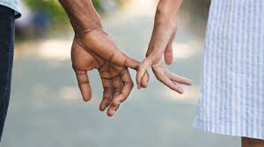
Intimate partner abuse in Teen Relationships: contexts, challenges and considerations
Dr Sarah Bekaert RN
Oxford Brookes University
The Centre for Criminal Justice and Security &
The Sir Arthur Lewis Institute of Social and Economic Studies
The University of the West Indies, Barbados, February 2024

Slide 2
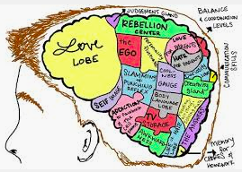
overview
Why teens?
Impacts of IPA
UK law
Qualitative experience
LGBTQ focus
Covid ‘gaps’
Neurological and socio-cultural aspects
Fragility and inexperience
IPA - health risks and deleterious developmental outcomes
underrecognised
Warrants specific focus

Slide 3

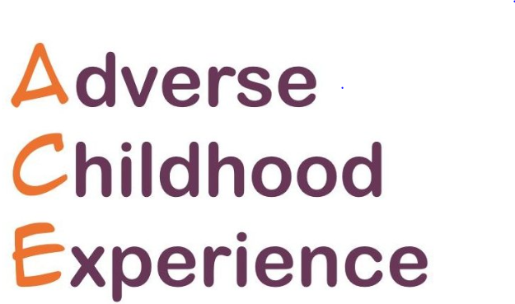
Teen IPA - impacts
Anxiety, depression, aggression
Post-traumatic stress disorder Substance use
Poor school performance
Suicide attempts
Self-harm
Foetal deaths, miscarriages, premature births

Slide 4
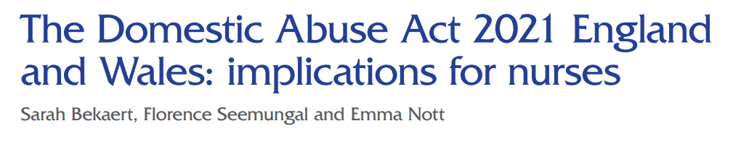

Domestic Abuse act
England & wales 2021
Behaviour of a person (“A”) towards another person (“B”) is “domestic abuse” if—
A and B are each aged 16 or over and are personally connected to each other, and the behaviour is abusive.
Behaviour is “abusive” if it consists of any of the following— physical or sexual abuse; violent or threatening behaviour; controlling or coercive behaviour, economic abuse (see subsection); psychological, emotional or other abuse; and it does not matter whether the behaviour consists of a single incident or a course of conduct.
“Economic abuse” means any behaviour that has a substantial adverse effect on B’s ability to— acquire, use or maintain money or other property, or obtain goods or services.
For the purposes of this Act A’s behaviour may be behaviour “towards” B despite the fact that it consists of conduct directed at another person (for example, B’s child).
Notes:
DAA 2021 1st legal definition of DA in E&W

Slide 5

Teenage pregnancy decision-making study
Violent contexts: relational, intergenerational, gendered, gangs, drugs and alcohol
Parenthood – permission to withdraw, fresh start
Reciprocal violence

Slide 6
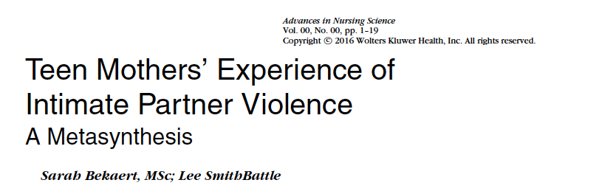

Metasyntheses
Two metasyntheses of literature:
- Teen mother’s experience of IPV (Bekaert & SmithBattle 2016)
- The experience of IPV in teenage relationships (Bekaert & Appleton 2021)

Slide 7
How teens describe the violence
Escalates over time
Purposeful and calculated/unreflective and spontaneous
An expression of deep feelings
Deserved
Ensuring their partner stayed with them
‘You wanna hold them. Keep them away from people … but then you don’t want to hold them, because like it’s pretty much gonna end the relationship’.
(Baker & Carreño, 2016, p315).

Slide 8
Digital media
Catalyst for violence
Making negative comments about photos or posts
Applying pressure to send intimate photos, redistributing intimate photos
Sending threatening messages
‘If you don’t return my phone calls, I will hunt you down. I will start at your house, and I will work my way from there’.
(Draucker & Martsolf 2010, p. 139).

Slide 9
Gendered aspects
Bidirectional, yet gendered
Young men - physical abuse, young women - psychological abuse
Self-defense and retaliation acceptable
‘Wow, you’re so psycho bitch. But it’s like – you made me like this’ .
(Baker et al 2015, p. 657)

Slide 10
Contextual considerations
‘Violence…it’s all around, you know? It’s just all around…like I’m walking down the street – this way the other day – and these guys ran up on me…and basically pulled a gun on me’ .
(Reed et al 2008, p. 266).
Learned behaviour
Part of general violence contexts
A pregnancy can compound entrapment

Slide 11
Adolescent development as resource
Impulse control
Fear of social ostracism
Less experience - limits exit strategies
Desistance occurred through development
Pivotal moments for change
‘It was just exciting to me at the time, but I grew out of it though’.
(Giordano et al 2015, p. 18).

Slide 12
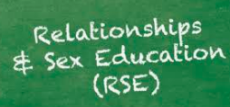


What can we do?
Curriculum based relationship education
Ask specifically about partner abuse
Be ready for the ‘pivotal’ moments
Trauma informed approach

Slide 13

LGBTQ relationships
Absent
Kubicek et al 2016, MSM:
Not a homogenous group
Survey data…
Involved both partners
Threatening to ‘out’ the other
Internalized homophobia
Alcohol and drugs
Rarely challenged: violence between two men is more acceptable in society

Slide 14

YRBSS 2021 Findings
more
 | Physical IPVV | Sexual IPVV
Heterosexual | 7.6 | 5
Lesbian or gay | 17 | 16.9
Bisexual | 25.3 | 23.3
Questioning | 17.5 | 13.6
Other | 20.9 | 19
Opp sex only | 16.6 | 12.7
Same sex only | 25.5 | 22.7
Both sexes | 44 | 43.1
ID
Tr
Act
Clayton et al 2023

Slide 15

observations
Intersection of gender and sexual orientation plays a significant role in who is most at risk
Fear of ‘outing’; reprisal and rejection
Limited understanding of LGBTQ IPA
Systemic inequities – legal definitions/policies that don’t include LGBTQ people
What can we do?

Slide 16
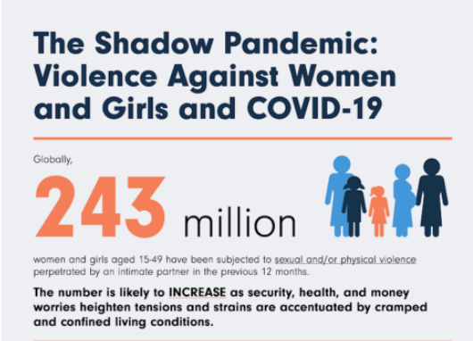
Notes:
Parallel increase in the incidence of domestic abuse (DA) ‘shadow pandemic’
Lasting impact? intensification coercive control and abuse, seeking to re-exert a control as ‘normality’ returns
Health and social care - trusted professionals – disclosure more likely
Covid – gap in social/experiential development - increased vulnerability

Slide 17
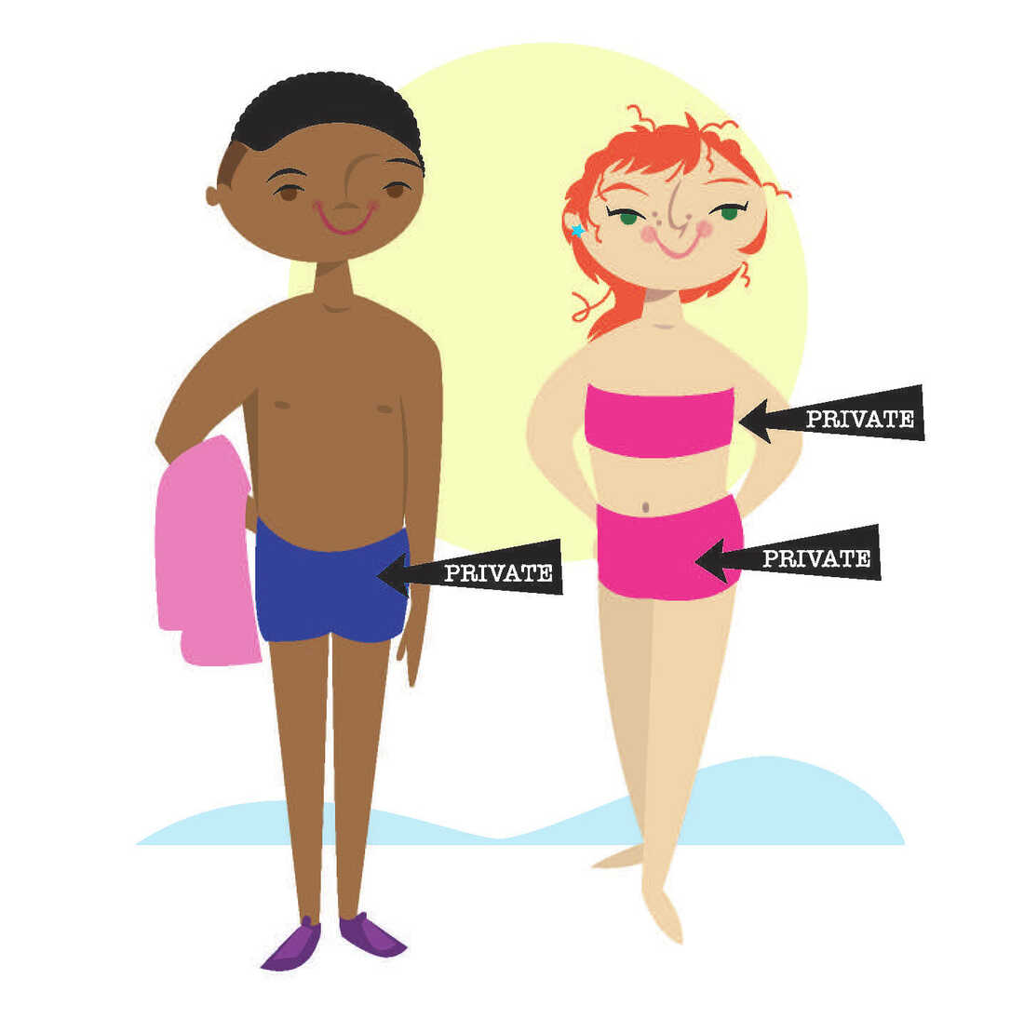
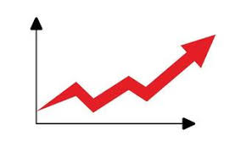

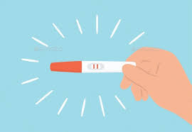
Covid ‘gaps’

Slide 18
Thankyou for listening!
sbekaert@brookes.ac.uk
@sarahbekaert
https://drsarahbekaert.net/

Slide 19



Current research
When it happened I didn’t want to talk about it at all, because I didn’t feel comfortable talking about it… To be honest it has helped me quite a lot as it’s shown me that there’s so much more to life. Casey, 15
Evaluating the impact of a Navigator mentorship programme for young people attending the Emergency Department as a result of violence
Thames Valley Police Violence Reduction Unit/Home Office (gov)
5 acute trusts across the Thames Valley
Mixed methods: quantitative engagement data/experiential accounts

